Slide 1
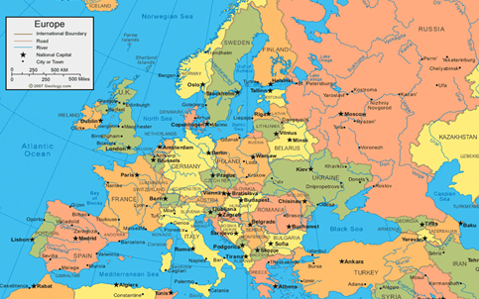
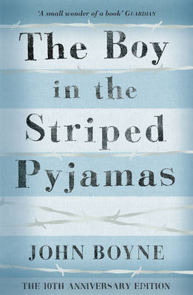
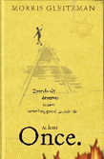
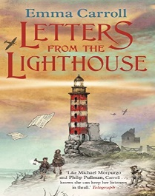
Is it right to fight? : KS2 Knowledge Organiser
Subject Specific Vocabulary |  |  | Exciting Books
Alliance | People, groups or states that have joined together for mutual benefit |  | History Skills
Armed Forces | The combined army, navy and air force of a nation, with members identifiable by their military uniform
Armistice Day | The day the agreement was signed between the Allies and Germany to end the war on 11th November.
Bias | To show an inclination (prejudice) for or against someone or something | Sticky Knowledge about ‘Is it right to fight?’
Invade | To enter forcefully as an enemy, with hostile intent to take possession
 |  | There have been many battles fought since 1066: Battle of Hastings, English Civil War, American Civil War, WW1, WW2, Korean War, Falklands War. Reasons for battles being fought are many and varied. (Reasons, chronology, key personnel, outcomes taught) | Select suitable sources of evidence giving reasons for your choice, and evaluate the usefulness and accuracy of it
Morale | The spirit a group has that makes them want to succeed, a sense of well-being
Propaganda | Controlling news media (such as radio) to depict the war effort | Weapons, uniforms and battle techniques have changes over time and influenced the way wars have been fought, e.g. Aircraft were still very new in 1914, so when the Germans launched bombing raids on London, they were carried out from airships, known as zeppelins | Begin to understand the concept of propaganda and that people can represent events in ways to persuade others
Truce | A stoppage of fighting between two or more people or sides in a conflict, especially a temporary one |  | Describe causes and consequences of main events and situations in wars and conflict from 1066 to present, plus changes over time
 |  | World War 2 was a battle between two groups of countries – the ‘Allies’ and the ‘Axis’. The major Allied powers were Britain, France, Russia, China and the United States. The major Axis powers were Germany, Italy and Japan.
War | A state of armed conflict between different countries or different groups within a country | Remembrance Day on 11th November is a memorial day observed in Commonwealth member states since the end of the First World War to remember the members of their armed forces who have died in the line of duty. The poppy is the enduring symbol of remembrance of the First World War. | Understand the legacy and impact of historical conflict for themselves and their identity
 |  |  | Empathetically understand different perspectives

Slide 2
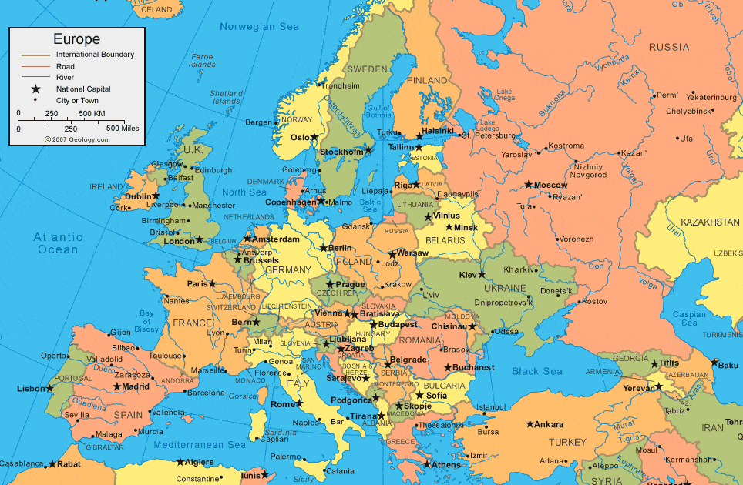
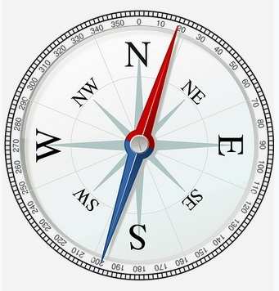
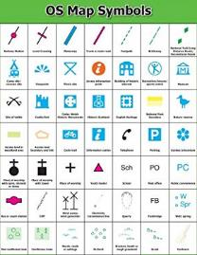
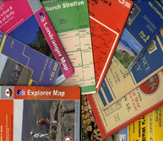
Is it right to fight? : KS2 Knowledge Organiser
Subject Specific Vocabulary |  |  | Exciting Books
Ordnance survey map | An Ordnance Survey map is a detailed map produced by mapping agency of the United Kingdom (UK).
Symbol | Map symbols are used to represent real objects. Both shapes and colours can be used for symbols on maps.
Key | A key is a list of all the symbols that appear on the map to help you interpret and understanding them. | Sticky Knowledge about ‘Is it right to fight?’ | Geography Skills
 |  |  | Use maps, atlases, globes and digital/computer mapping to locate countries
Grid reference | Grid references define locations in maps using coordinates. Grid lines on maps are numbered to provide a unique reference to each location on the map. This reference is normally based on projected eastings and northings | The United Kingdom is located off the northwestern coast of mainland Europe. The United Kingdom comprises the whole of the island of Great Britain—which contains England, Wales, and Scotland—as well as the northern portion of the island of Ireland.
 |  |  | Use maps, atlases, globes and digital/computer mapping to locate countries and describe features studied
Compass | A compass is a tool for finding direction. A compass has a magnetic needle. The needle, which can spin freely, always points north. | Names and locations of counties and major cities of the United Kingdom and Europe
 |  |  | Use symbols and key on Ordnance Survey maps to build knowledge of the United Kingdom and the wider world
Eight points of a compass | The 4 main points are North, South, East and West (going clockwise they are NESW). Halfway between each of these is North-East, South-East, South-West and North-West. | There are 44 countries in Europe. A small number of countries on the continent are transcontinental, meaning they are considered to be a part of both Europe and Asia.
 |  |  | Use the 8 points of a compass, 4- and 6-figure grid references
Memorial site | A memorial is an object which serves as a focus for the memory or the commemoration of something. | Human geography features include: types of settlement / land use, economic activity / trade links, and distribution of natural resources including energy, food, minerals and water
 |  |  | Use 4- and 6-figure grid references
Commemorate | To commemorate something means to remember something and by doing so to honour it. | Physical geography features include: climate zones, biomes and vegetation belts, rivers, mountains, volcanoes and earthquakes, and the water cycle | Identify similarities and differences between places

