Slide 1
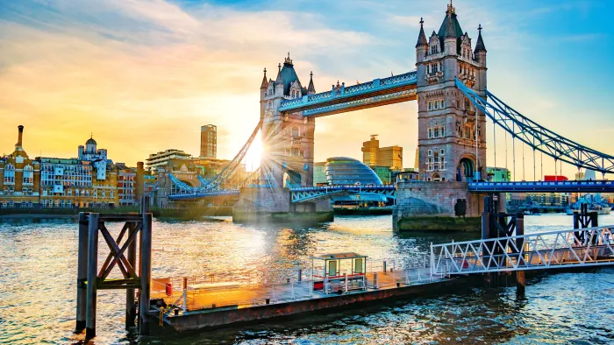
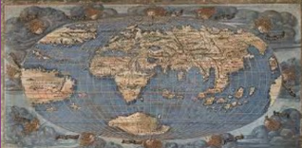
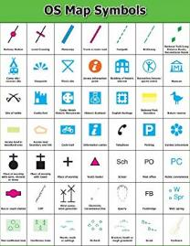
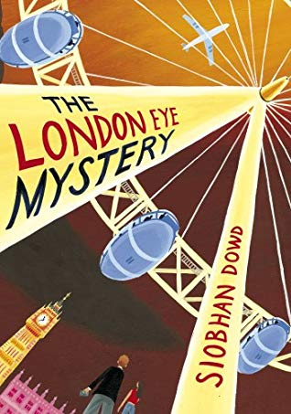
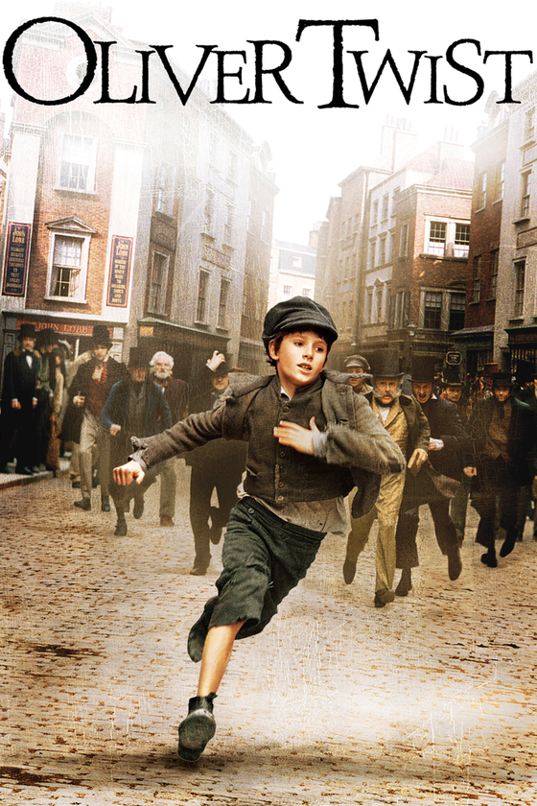
London: KS2 Knowledge Organiser
Subject Specific Vocabulary |  |  | Exciting Books
Ordnance Survey | An Ordnance Survey map is a detailed map produced by mapping agency of the United Kingdom (UK). |  | Geography Skills
symbol | Map symbols are used to represent real objects. Both shapes and colours can be used for symbols on maps.
river | A river is a flowing, moving stream of water. Usually a river feeds water into an ocean, lake, pond, or even another river.
 |  | Sticky Knowledge about London
Physical feature | Physical characteristics are defining traits or features about the location. | London is the capital city of Great Britain and is a diverse and vibrant place
Human feature | Human geography relates only to the human environment; something that is built by humans and would not have existed in nature without humans. | A key physical feature is the River Thames around which London was developed. It is 296 km long, making it the longest River walk in Europe.
Tourist attraction | A place that people visit for pleasure and interest, usually while they are on holiday | Human features have changed and evolved over time: tourist attractions, density/population, street planning. The London Underground is a system of electric trains and is the oldest underground railway in the world. There are 402 km of lines.
grid reference | Numerical grid references consist of an even number of digits. Eastings are written before Northings. |  | Compare and contrast 2 locations (human and physical features)
 |  | The world map that is familiar to most of us is the Mercator projection, but it is full of distortions so some countries appear larger or smaller than they actually are.
aerial photograph | Aerial photography is the taking of photographs of the ground from an elevated/direct-down position. |  | Locate countries and describe features studied using maps, atlases, globes and digital/computer mapping
Greenwich meridian | The prime meridian is the imaginary line that divides Earth into two equal parts: the Eastern Hemisphere and the Western Hemisphere, often called the Greenwich meridian.
 |  | There are two norths: true north and magnetic north. True north is the direction of the geographic North Pole. Magnetic north is the direction the north end of a needle in a compass points. | Use six-figure grid references
 |  |  | Record and present human and physical features using a range of methods
Capital city | A capital city is a city or town, specified by law or constitution, by the government of a country, or part of a country, such as a state, province or county. It usually serves as the location of the government's central meeting place and offices.
 |  |  | Use the 8 points of a compass

