Slide 2
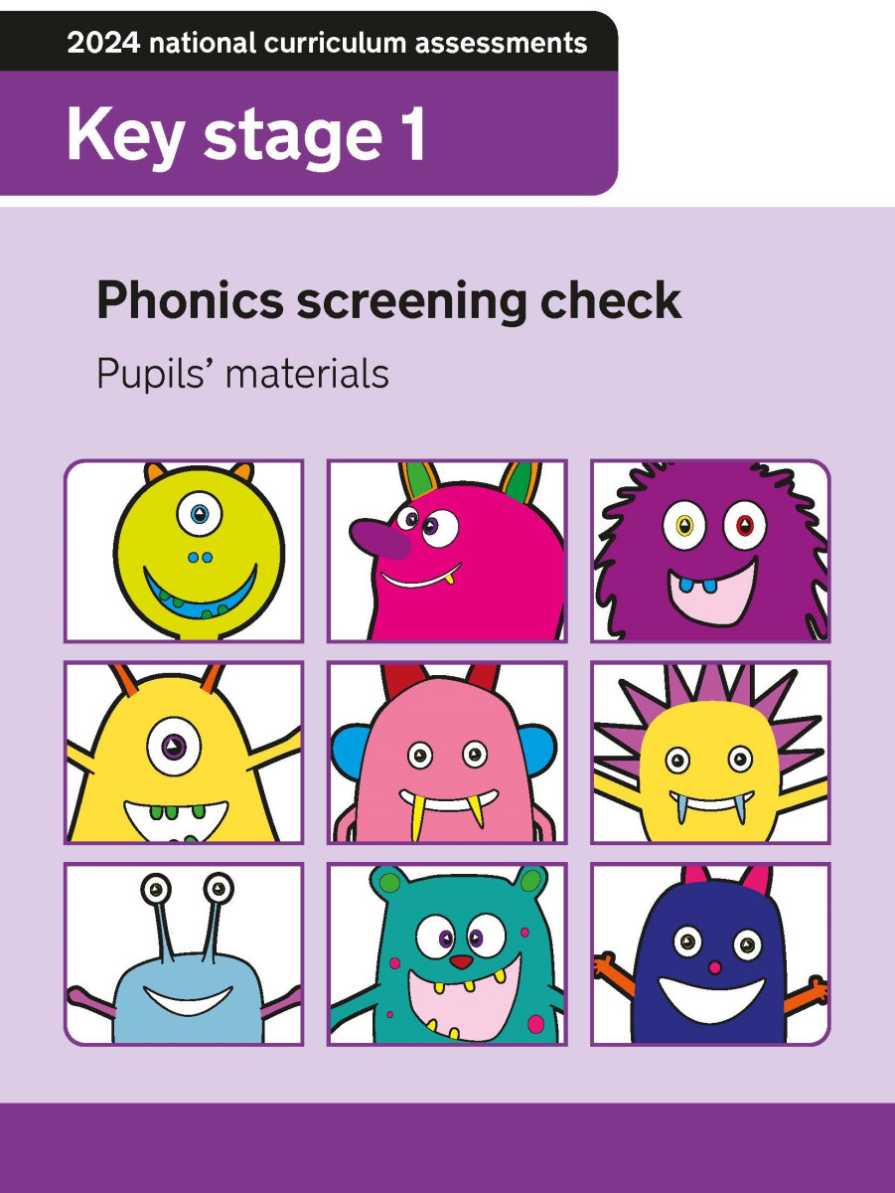
What is the Phonics Screening check?
The Phonics Screening Check (PSC) is a short assessment which confirms whether individual children have learnt phonic decoding to an appropriate standard.
The PSC is designed to assess a child’s phonics skills, ensuring they can decode words by blending sounds, using 20 real words and 20 made-up (pseudo) words in a one-on-one reading session.

Slide 3
Who, When and Where?
Who?
The children will complete the screening with a familiar adult. The test will be completed on a 1:1 basis.
Where?
The screening will take place in school, away from the classroom, in a quiet, distraction-free space.
When?
The screening window opens for Grappenhall Heys on 8th of June 2026 and remains open for the whole school week, giving staff plenty of time to administer the check with your child. Please ensure your child is in school. If your child is poorly, we will make alternative arrangements in line with guidance.

Slide 4
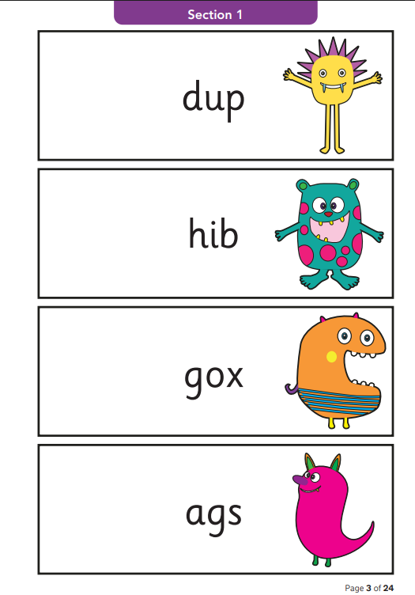
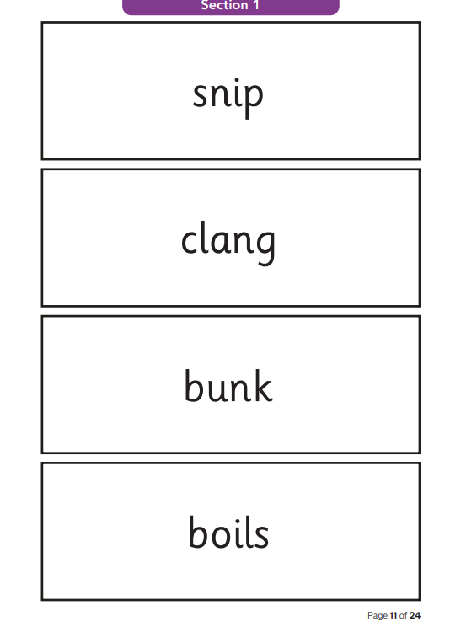
The format of the test
The test is made up of 20 real words and 20 pseudo words. The children will be expected to decode all 40 words using their phonics knowledge.
Pseudo words are made clear in the booklet with a picture of an alien next to them (explaining the children calling them ‘alien’ words).
Children can take as long as they need to decode a word, but we cannot help or prompt them.

Slide 5
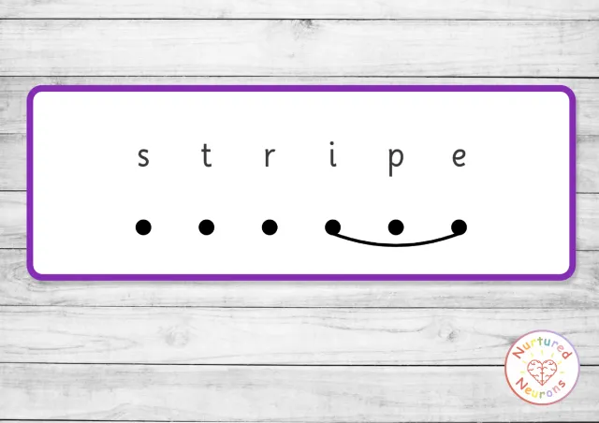
Adaptation, where needed
The check is not timed but we expect it will take each pupil between 4 and 9 minutes to complete. We will give each child enough time to respond to each word. If we believe a child will find it difficult to concentrate, or may experience fatigue during the check, we may use rest breaks to make it more manageable. We can give rest breaks whenever they are needed.
Filters and overlays are permitted if they are part of normal classroom practice for your child.
If a pupil uses sound buttons to help them decode words as part of normal classroom practice, they may use them during the check. The pupil will receive a clean copy of the check so they can mark the sound buttons against the graphemes because we must not mark the graphemes for them.
The children have been taught this in class and practice it regularly.

Slide 6
Sharing results and information with you
As a school we find out the threshold pass mark on 22nd June 2026.
In previous years this has been 32/40, but this is subject to change.
Your child’s results will be shared with you in their end of year report.
If your child is unable to sit the screening this year for any reason, or they do not meet the threshold, they will resit the screening the following year, in Year 2.

Slide 7
How will we support in school?
Phonics homework moving forward will be tailored around preparing the children for the assessment. We will also post past paper and replicated screening content. Interactive homework will support this offer.
We will send home a pack over Easter and the May half terms to support you.
We will continue to track and closely monitor each child’s progress towards this assessment and will share any tailored support with parents, where necessary.
We will be here to answer any questions or provide any further support you feel you need.
We are moving to two phonics sessions daily to support retention and practice. This has proved to be effective in previous years.

Slide 8
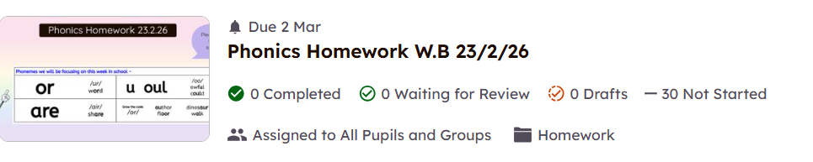

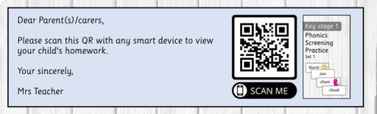



How can you support at home?

Slide 9
Thank you for your continued support
Any questions?

